Slide 1
Linux Internals and Embedded Systems
Day 38
Linux Device Driver Training
Presented by,
Ganavi M
Ganavigowda512@gmail.com

Slide 2
What is Linux ?
Linux is an operating system that was initially created as a hobby by a young student, Linus Torvalds, at the University of Helsinki in Finland.
Linus began his work in 1991 when he released version 0.02 and worked steadily until 1994 when version 1.0 of the Linux Kernel was released.
The kernel, at the heart of all Linux systems, is developed and released under the GNU General Public License (GPL) and its source code is freely available to everyone (http://www.kernel.org).

Slide 3
Linux Kernel Version
The first official release of Linux 1.0 was in March 1994.
Just a year later, Linux 1.2 was released.
Linux 2.0 arrived in June 1996.
Linux 2.2 in January 1999.
Linux 2.4 in January 2001.
Linux 2.6 in December 2003.

Slide 4
Linux - Why Popular ?
Royalty-free – Open Source
• Strong networking support
• Standard (UNIX/POSIX) interface
• Growing number of embedded distributions
• Availability of support
• Modern OS (eg. memory management, kernel modules, etc.)

Slide 5
Linux Features
Written in High Level Language ‘C’
Monolithic
Layered Approach
Simple User Interface
Hierarchical File System
Dynamic Module Loading Support
Pre-emptive Kernel

Slide 6
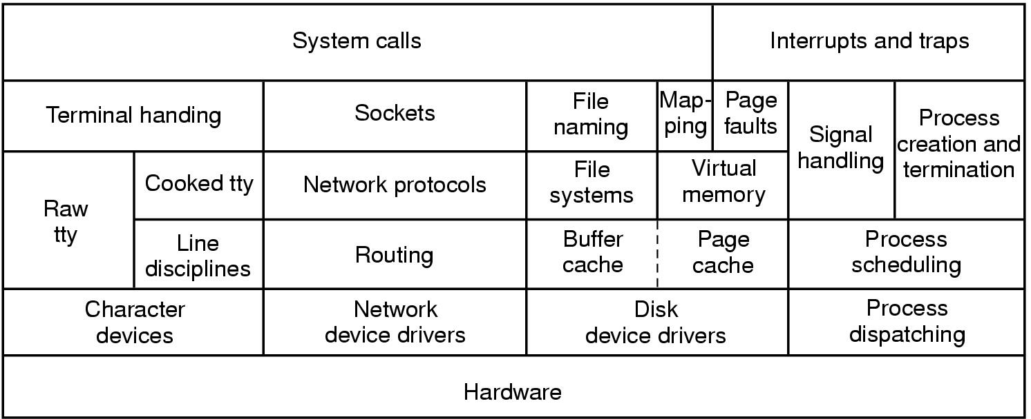
General Structure of Linux kernel

Slide 7
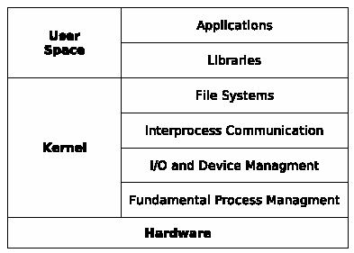
Monolithic Kernel

Slide 8
Monolithic Kernel
It runs every basic system service like process and memory management, interrupt handling and I/O communication, file system, etc. in kernel space
It is constructed in a layered fashion, built up from the fundamental process management up to the interfaces to the rest of the operating system (libraries and on top of them the applications).
The inclusion of all basic services in kernel space has three big drawbacks: the kernel size, lack of extensibility and the bad maintainability. Bug Fixing or the addition of new features means a recompilation of the whole kernel.

Slide 9
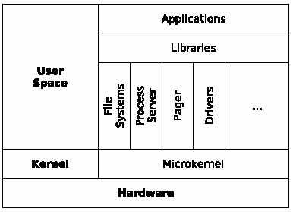
Micro Kernel

Slide 10
Micro Kernel
To overcome these limitations of extensibility and maintainability, the idea of micro kernels appeared at the end of the 1980's.
The concept was to reduce the kernel to basic process communication and I/O control, and let the other system services reside in user space in form of normal processes (as so called servers).
There is a server for managing memory issues, one server does process management, another one manages drivers, and so on.
Ack: Benjamin Roch and TU Wien

Slide 11
System Calls
$ vi /usr/src/linux/arch/i386/kernel/entry.S
Library functions will call internally a system call. Every system call has a +ve integer number and will be executed in Kernel mode.
For example - printf C library function calls internally write system call.
Information about System Calls, refer man 2 <system call name>
Notes:
Total number system calls at present in 2.6 kernel:

Slide 12
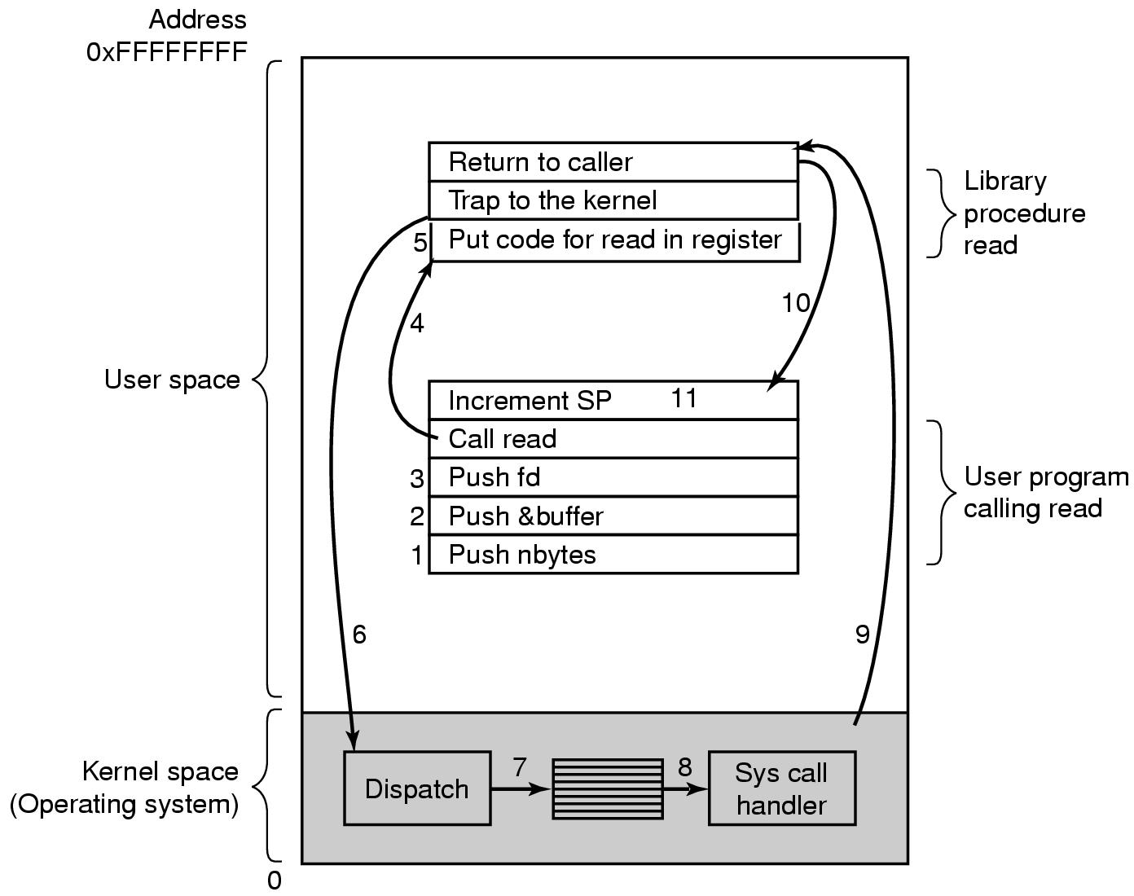
Steps in Making a System Call
read (fd, buffer, nbytes);

Slide 13
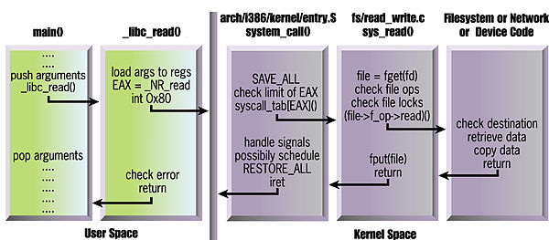
Steps to Perform read ( )
Ack to Linux Magazine and A Rubini

Slide 14
File Management
The basic model of I/O system is a sequence of bytes (and there are no file format) that can be accessed either randomly, or sequentially.
The I/O system is visible to a user process as a stream of bytes (I/O stream). A Linux process uses descriptors to refer I/O streams.

Slide 15
File Descriptor (fd)
0 - stdin
The system calls related to the I/O system take a descriptor as an argument to handle a file.
The descriptor is a positive integer number.
If a file open is not successful, fd returns -1.
Linux supports different types of files.
1 - stdout
2 - stderr
3 - file1
4 - file2
fd table

Slide 16
File Descriptor (fd)
0 - stdin
0 - stdin
1 - stdout
1 - stdout
Term-2
Terminal-1
2 - stderr
2 - stderr
3 - file1
File 1
3 - file1
4 - file2
4 - file3
Descriptor Table Process 1
Descriptor Table Process 2
File 2
File 3

Slide 17
File Management –File Systems
$man fs lists the familiar file systems with brief description
The term file system refers to –
Some code in the kernel that is activated in response to a program using file I/O system calls (such as open, read, write, close etc). In other words, file system facilitates file related system calls.
A set of data structures (such as I-node table, mounted file systems table etc.) used to track the usage of a device.

Slide 18
File Systems
A file system enables storage of –
names of ordinary files and directories
the data contained in ordinary files and directories
the names of device special files

Slide 19
File Systems - Creating
When a file system is created, Linux creates a number of blocks on that device. These blocks are
B
S
inode table
Data blocks
Boot block contains bootstrap code, which is used when the system is booting.

Slide 20
File Systems – Super block
Each device also contains more than one copies of the super-block- as the super-block contains information that must be available to use the device.
If the original super-block is corrupt, an alternate super-block can be used to mount the file system.

Slide 21
File Systems - Superblock
The super-block contains info. such as:
a bitmap of blocks on the device, each bit specifies whether a block is free or in use.
the size of a data block
the count of entries in the I-node table
the date and time when the file system was last checked
the date and time when the file system was last backed up

Slide 22
File Systems – I-node table
The I-node table contains an entry for each file stored in the file system. The total number of I-nodes in a file system determine the number of files that a file system can contain.
When a file system is created, the I-node for the root directory of the file system is automatically created.

Slide 23
File Systems – I-node table
Each I-node contains following info:
file owner UID and GID
file type and access permissions
date/time the file was created, last modified, last accessed
size of the file
number of hard links to the file
Each I-node entry can track a very large file

Slide 24
Device Special Files
A device special file describes following characteristics of a device :
Device name
Device type (block device or character device)
Major device number
Minor device number
Each file system must be mounted before it can be used. Normally, all file systems are mounted during system startup.
Each file is located on a file system. Each file system is created on a device, and associated with a device special file.
Therefore, when you use a file, UNIX can find out which device special file is associated with that file and send your request to a particular device driver.

Slide 25
FS - Mounting
The “dev” directory contains names of each device special file. Therefore each device special file name is also stored in a device.
A file system is mounted typically under an empty directory. This directory is called the “mount point” for the file system.
You can use mount command to find how many file systems are mounted, and what is the mount point for each file system :
$ mount
/dev/hda2 on / type ext2 (rw)
none on /proc type proc (rw)

Slide 26
FS– Internal Routines
The file system contains a number of internal support routines that are used for accessing a file.
namei( )
iget() / iput( )
bread( )
bwrite( )
getblk( )
Notes:
The file system contains a number of internal support routines that are used for accessing a file.
namei() (convert a “pathname” into an I-node number).
iget()/iput( ) (reads/writes an I-node)
bread() (read a block from buffer cache/disk)
bwrite() (write a block from buffer cache to disk)
getblk() (get a free block in the buffer cache, where bread can stored it’s data)

Slide 27
Buffer Cache
The file system also maintains a buffer cache.
The buffer cache is stored in physical memory (non-paged memory).
The buffer cache is used to store any data that is read from or written to a block-device such as a hard-disk, floppy disk or CD-ROM.

Slide 28
Buffer Cache
If data is not present in buffer cache:
the system allocates a free buffer in buffer cache
reads the data from the disk
stores the data in the buffer cache.
If there is no free buffer in the buffer cache:
the system selects a used buffer
writes it to the disk
marks the buffer as free
allocates it for the requesting process.
While all this is going on, the requesting process is put to wait state.
Once a free buffer is allocated and data is read from disk into buffer cache, the process is resumed.
A process can use the sync( ) system call to tell the system that any changes made by itself in the buffer cache must be written to the disk.

Slide 29
File I/O –System Calls
System calls for file I/O
open - To open or create a file
read,write - To perform file I/O
lseek - To seek to a location in the file
close - To close an open file
dup,dup2 - To duplicate the file descriptors
fcntl - File control
stat - To obtain information about a file

Slide 30
Introduction to Process
A process can be thought of as a program in execution
Process also include PC and all CPU registers as well as the process stacks containing temporary data
During the lifetime of a process it will use many resources
Os should keep track of the processes to ensure that the system resources are shared fairly.
Most precious resource is CPU. Since UNIX is a multiprocessing OS, its main objective is to have maximum CPU utilization

Slide 31
Dual Modes
In order to run Linux, the computer hardware must provide two modes of execution: User and Kernel.
Each process has virtual address space, references to virtual memory are translated to physical memory locations using set of address translation maps
When current process yields CPU to another process (a context switch), the kernel loads these registers with pointers to translation of new process

Slide 32
Per-process Objects
There are two important per-process objects
* uarea (user area) – is a data structure that contains information about a process of interest to the kernel, such as a table of files opened by the process, identification information, and saved values of the process registers when the process is not running
* kernel stack – to keep track of its function call sequence when executing in the kernel.
Both u area and kernel stack, while being per-process entities in the process space, are owned by the kernel

Slide 33
Context of a Process
The UNIX kernel is reentrant
Kernel functions may execute either in process context or in system context
User code runs in user mode and process context, and can access only the process space
System calls and exceptions are handled in kernel mode but in process context, and may access process and system space
Interrupts and system wide tasks are handled in kernel mode and system context, and must only access system space

Slide 34
Process Structure
In order to manage the processes in the system, each process is represented by a task_struct data structure
The task vector is an array of pointers to every task_struct data structure in the system.
task_struct is quite large and complex

Slide 35
Process State
As a process executes it changes state according to its circumstances. Standard UNIX processes have the following states:
Ready
Running
Wait
stopped
Zombie
Exit

Slide 36
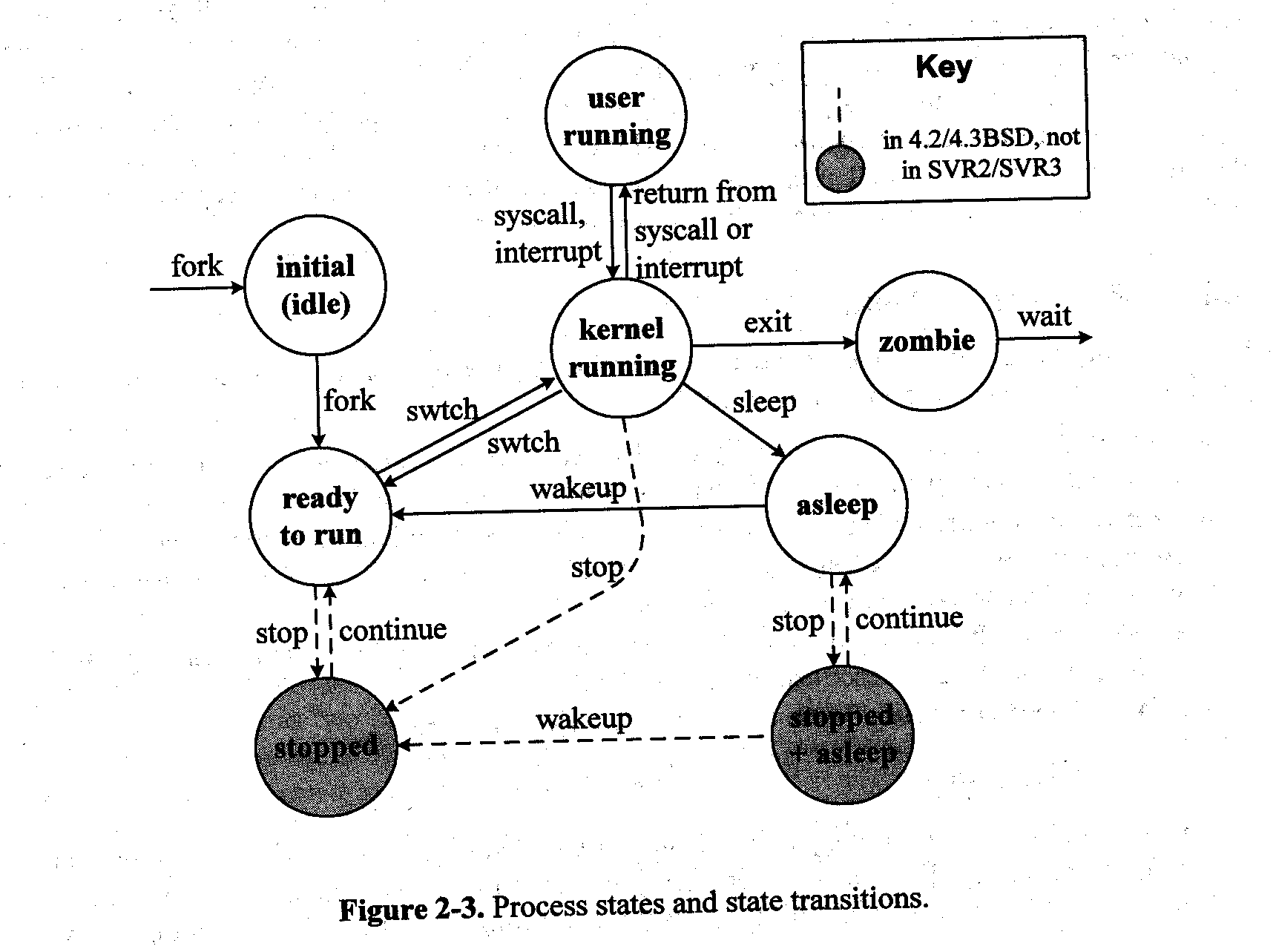
Process -state transition
Stopped
+ Asleep
stopped

Slide 37
Identifiers
Every process in the system has a process identifier.
Each process also has User and group identifiers, these are used to control this processes access to the files and devices in the system
ppid, pid, uid, gid, euid, egid

Slide 38
init - shell
In Linux no process is independent of any other process
Every process in the system, except the initial process has a parent process
New processes are not created, they are copied, or rather cloned from previous processes
init
getty
login
shell

Slide 39
Times and Timers
The kernel keeps track of a processes creation time as well as the CPU time that it consumes during its lifetime
Each clock tick, the kernel updates the amount of time that the current process has spent in system and in user mode
UNIX also supports process specific interval timers, processes can use system calls to set up timers to send signals to themselves when the timers expire

Slide 40
Process Scheduling
scheduler that must select the most deserving process to run out of all of the processes in the ready to run queue. The traditional UNIX scheduler uses preemptive round-robin scheduling
Scheduling priorities have integer values between 0 and 140, with smaller numbers meaning higher priorities

Slide 41
Process Scheduling
For the scheduler keeps information in the task_struct for each process
policy This is the scheduling policy that will be applied to this process.
priority This is the priority that the scheduler will give to this process.
rt_priority Linux supports real time processes and these are scheduled to have a higher priority than all of the other non-real time processes in system.
counter This is the amount of time that this process is allowed to run for.

Slide 42
Creating a new process
fork( ) system call creates a new process
All statements after the fork( ) system call in your program are executed by two processes
If fork ( ) returns 0 it is a child process else if > 0 it is parent process else (-1) error
A parent process can use the wait( ) system call to wait for the exit of any child process

Slide 43
Process Creation
Resource sharing
Parent and children share all resources
Children share subset of parent’s resources
Parent and child share no resources
Execution
Parent and children execute concurrently
Parent waits until children terminate
Address space
Child duplicate of parent
Child has a program loaded into it

Slide 44
exec – to run a program
To run a new program in a process, use one of the “exec” family of calls
pathname of the program to run
name of the program
each parameter to the program
(char *)0 as the last parameter to specify end of parameter list
fork ( ) demo

Slide 45
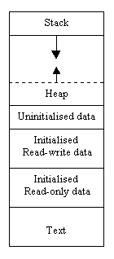
Process Image
User context
Kernel context
Kernel data
$ size a.out (man size )
text data bss dec hex filename
920 268 24 1212 4bc a.out

Slide 46
Signal Handling

Slide 47
Signals -Introduction
Signals are requests sent to a process, causing it to divert its execution to do something else Signals are software interrupts
Signals provide a way of handling synchronous or asynchronous events depends on its nature.
Each signal has an integer number
Symbolic name is defined in the file /usr/include/bits/signum.h
Refer $man 7 signal
$kill –l

Slide 48
List of Signals
$ kill -l
1) SIGHUP 2) SIGINT 3) SIGQUIT 4) SIGILL
5) SIGTRAP 6) SIGIOT 7) SIGBUS 8) SIGFPE
9) SIGKILL 10) SIGUSR1 11) SIGSEGV 12) SIGUSR2
13) SIGPIPE 14) SIGALRM 15) SIGTERM 17) SIGCHLD
18) SIGCONT 19) SIGSTOP 20) SIGTSTP 21) SIGTTIN
22) SIGTTOU 23) SIGURG 24) SIGXCPU 25) SIGXFSZ
26) SIGVTALRM 27) SIGPROF 28) SIGWINCH 29) SIGIO
30) SIGPWR 31) SIGSYS

Slide 49
Signal Generation
Kernel generates signals to process in response to various events. Some major sources of signals are:
Exceptions
other process
Terminal interrupts
Job control
Quotas
Notifications
Alarms

Slide 50
Signal Handling
When the signal is sent to the process, the operating system stops the execution of the process, and "forces" it to call the signal handler function
Each signal has a default signal handler, which is a function that gets called when the process receives that signal
Catch the Signal: instead of executing a default signal handler, the control should execute a given signal handler.
Two signals SIGSTOP and SIGKILL cannot catch, they cause the process to terminate immediately. This is useful when debugging programs whose behavior depends on timing.

Slide 51
Signal Vs Interrupt
Signals are very similar to hardware interrupts in their behavior
The difference is that while interrupts are sent to the operating system by the hardware. For example: clock interrupt, page fault, device interrupt
Signals are sent to the process by the operating system, or by other processes

Slide 52
Signal System Call
signal (int signum, sighandler_t handler);
The signal() system call is used to modify a default action of a specified signal
signal() accepts a signal number and a pointer to a signal handler function

Slide 53
Kill –System Call
Sending a given signal to the specified pid.
int kill(pid_t pid, int sig);
The kill ( ) system call is used to send a given signal to the specified process(es). It accepts two arguments, signal and pid

Slide 54
Pre-defined Handlers
signal (SIGINT, (void *) our_handler);
kill (SIGINT, pid );
SIG_IGN
Causes the process to ignore the specified signal.
SIG_DFL
Causes the system to set the default signal handler for the given signal

Slide 55
User Level Threads

Slide 56
POSIX Threads
Thread is a sequential flow of control through a program.
If a thread is created, it will execute a specified function.
Two type of threading: 1. Single Threading 2. Multi threading
All threads within a process share 1. process instructions 2. address space, data 3. Open files ( example: file descriptors) 4. Signal Handlers 5. Current working directory, uid and gid
Each thread has its own 1. Thread id 2. set of registers, pc, sp 3. stack (for local variables and return addresses)

Slide 57
POSIX Threads
Advantages of Threads
1. It takes less time to create a new thread in a process 2. It takes less time to terminate a thread than a process 3. It takes less time to switch between two threads within the same process 4. Communication between threads are easier.
There are two broad categories of thread implementation: 1. User level Threads (ULT)
2. Kernel level threads (or kernel-supported threads or Light weight processes)
#include <pthread.h>
Thread management is done by the application and the kernel is not aware of the existence of threads. Thread library contains code for creating and destroying threads, passing messages and data between threads, for scheduling thread execution and for saving and restoring thread contexts

Slide 58
POSIX Threads
This thread application are allocated to a single process managed by the kernel
All the activity takes place in user space and within a single process. kernel is unaware of this activity; the kernel continues to schedule the process as a unit and assigns a single execution state to that process
Advantages: Thread switching does not require kernel mode, Scheduling can be application specific and can run on any OS
Disadvantage: When it executes a system call, not only is that thread is blocked, but all the threads within the process are blocked.

Slide 59
Kernel Threads​
Thread management is done by the kernel.
Advantage: If one thread in a process is blocked, kernel can schedule another thread of the same process.
Disadvantage: Transfer of control from one thread to another within the same process requires a mode switch to the kernel

Slide 60
Threads –Comparison
Comparison of creation and synchronization time of ULT, LWP & Process CREATION TIME SYNCHRONIZATION TIME
(μ sec) (μ sec)
ULT 52 66
LWP 350 390
Process 1700 200

Slide 61
Threads -Applications
Improve application responsiveness
Use multiprocessors more efficiently
Improve program structure
use fewer system resources
Specific applications in uniprocessor machines
Applications
A file server on a LAN
Graphical User Interfaces (GUIs)
web applications

Slide 62
Threads –OS implementation
one process
one thread
one process
multiple threads
multiple processes
one thread per process
multiple processes
multiple threads per process
Notes:
One process –one thread: Dos
One process –multiple thread : windows
Multiple process –one thread per process: unix process
Multiple process and multiple thead per process – Linux ,Solaris, windows NT

Slide 63
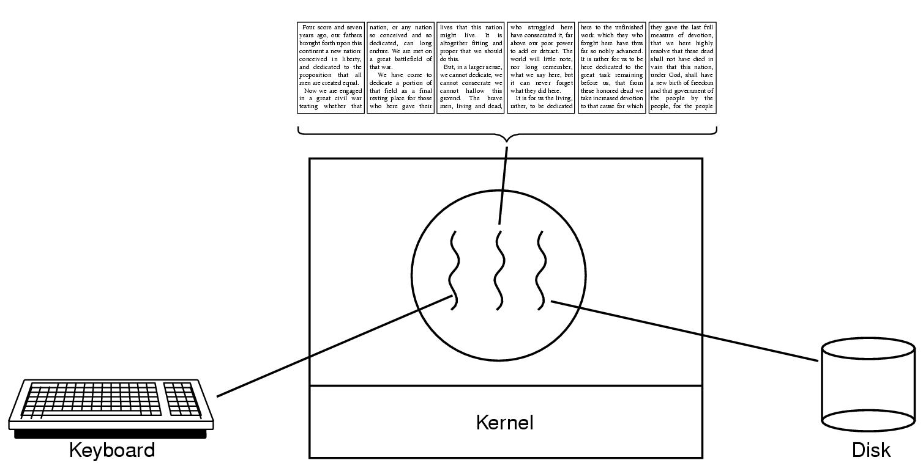
Thread Usage
A word processor with three threads

Slide 64
Hello Thread Example
#include <pthread.h>
void thread_function (void) {
printf (“ Hello POSIX Thread\n”);
}
main ( ) {
pthread_t mythread;
pthread_create ( &mythread, NULL, thread_function, NULL);
}
$cc thread.c -lpthread

Slide 65
Primitive IPC

Slide 66
IPC - Introduction
Traditionally this term described different ways of message passing between different processes
A complex programming environment often multiple processes must communicate with each other and share some resources and information.
Interprocess interactions have several distinct purposes:
* Data transfer * Sharing data
* Event notification * Resource sharing
* Process control

Slide 67
IPC Mechanisms
Primitive IPC
Pipe
FIFO
System V IPC
Message Queues
Shared Memory
Semaphores

Slide 68
Persistence of IPC Objects
termination of a process or closes the ipc object
process
Exists until kernel reboots
or IPC object is explicitly
deleted
kernel
File system
Until the object is explicitly deleted

Slide 69
Complexity trends in OS
OS functionality drives the
complexity
Small controllers
sensors
Home appliances
Mobile phones
PDAs
Game Machines
Router

Slide 70
Requirements of EOS
Memory Resident: size is important consideration
Data structure optimized
Kernel optimized and usually in assembly language
Support of signaling & interrupts
Real-time scheduling
tight-coupled scheduler and interrupts
Power Management capabilities
Power aware schedule
Control of non-processor resources

Slide 71
Embedded OS Design approach
Traditional OS: Monolithic or Distribute
Embedded: Layered is the key (Constantine D. P, UIUC 2000)
Power
Management
Basic Loader
Interrupt & signalling
Real-Time Scheduler
Memory Management
Custom device
support
Networking support

Slide 72
Power Management by OS
Static Approach: Rely on pre-set parameters
Example: switch off the power to devices that are not in use for a while (pre-calculated number of cycles). Used in laptops now.
Dynamic Approach: Based on dynamic condition of workloads and per specification of power optimization guidelines
Example: Restrict multitasking progressively, reduce context switching, even avoid cache/memory access, etc..

Slide 73
Popular E-OS
WinCE (proprietary, optimized assembly..)
VxWorks
Micro Linux
MuCOS
Java Virtual Machine (Picojava) OS
Most likely first open EOS!

Slide 74
Interrupts
Each device has 1-bit “arm’ register to be set by software if interrupt from the device to be accepted.
CCR is used to program the interrupts
A good design should provide for extensibility in the number of devices that can issue interrupts and also number of ISRs.
Either polled or vectored interrupts depending on nature of processors and I/O devices.
Polling: Dedicated controllers, data acquisition with periodicity and the I/O devices are slow
Interrupts: Real-time environments, when events are unpredictable and asynchronous

Slide 75
Direct Memory Access
DMA is used when low latency and/or high bandwidth is required. (disk IO, video output or low latency data acquisition)
Software DMA: starts with normal interrupts, the ISR sets the device resisters and initiate I/O, processor returns to normal operation, on completion of I/O device inform the processor.
Hardware DMA: the above can be implemented in hardware
Burst DMA: when buffers are put in I/O devices (disk)
Low latency asynchronous I/O can not use burst DMA.

Slide 76
Real-Time Scheduling
Interrupts are heavily used in scheduling when real-time events are to be completed by some deadline.
Events or threads or tasks or processes need to use priority, deadline, blocking, restoring and nesting
NP-hard problem with out an optimal solution.
Greedy heuristics are proposed as working solutions with some assumptions.
Dynamic RT Scheduling: Use greedy heuristics together with priority-based interrupts.

Slide 77
OS directed power reduction
Dynamic power management: determine the power state of a device based on the current workload, move through the power transitions based on shot down policy
Usually, in stead of power off/on, there are dynamic voltage setting and variable clock speeds => multiple power states
Previous works:
Shot down device if idle long enough
Hardware centric => observe past requests at device to predict future idleness, no OS info, no study on characteristics of requsters
Use stochastic model and assume randomly one request without distinguishing the source of the requester

Slide 78
OS directed power reduction
Disk request sources: compiler, text editor, ftp program
Network card: internet browser or telnet session?
Important that we have accurate model of requesters in concurrent environment.( Task Based Power Management) A software-centric approach
Two methods to reduce power: adjust CPU clock speed, sleeping states

Slide 79
Process states
new
terminated
admitted
interrupt
exit
ready
running
Scheduler
dispatch
IO or event
completion
IO or event
wait
waiting

Slide 80
Introduction to Embedded Linux​

Slide 81


Simplified Linux system architecture​

Slide 82

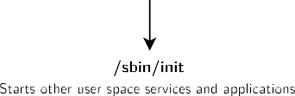
Overall Linux boot sequence​

Slide 83
Embedded Linux work
BSP work: porting the bootloader and Linux kernel, developing Linux device drivers.
system integration work: assembling all the user space components needed for the system, configure them, develop the upgrade and recovery mechanisms, etc.
application development: write the company-specific applications and libraries.

Slide 84
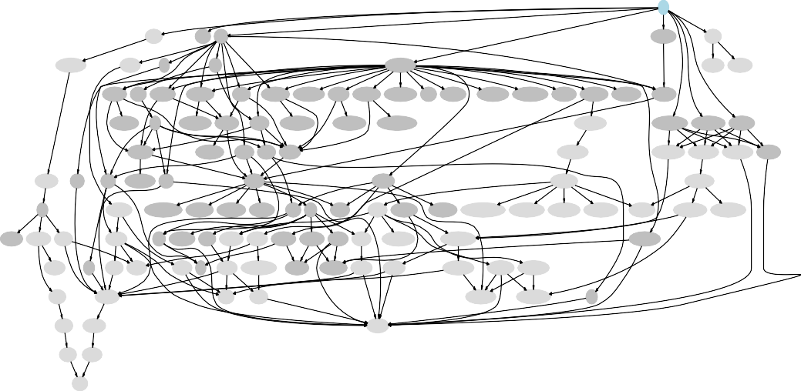
Complexity of user space integration
ALL
toolchain
busybox libgtk3
xapp_xkbcomp
rootfs-tar
toolchain-buildroot
host-libgtk3
atk
pango
xserver_xorg-server
host-fakeroot host-makedevs
xlib_libXrandr harfbuzz xlib_libXcursor
xlib_libXdamage
xlib_libXi xlib_libXinerama xproto_xcmiscproto xlib_libXres xlib_libXxf86vm xproto_xf86dgaproto mcookie xdata_xbitmaps
xproto_bigreqsproto
xproto_compositeproto xproto_glproto xkeyboard-config xproto_videoproto
xlib_libxkbfile
xproto_randrproto cairo
xproto_damageproto xlib_libXfixes xlib_libXft xproto_xineramaproto
xproto_resourceproto
xproto_xf86vidmodeproto
host-xapp_xkbcomp
xfont_font-cursor-misc
xfont_font-misc-misc xfont_font-alias
xlib_libXrender
xproto_fixesproto gdk-pixbuf fontconfig xlib_libXext
host-xlib_libxkbfile
host-xapp_mkfontdir host-xapp_bdftopcf host-xfont_font-util xfont_font-util
host-gcc-final libsha1
libglib2 xproto_renderproto pixman
xlib_libX11
xlib_libXfont
host-xlib_libX11
host-xlib_libXfont
glibc
host-gdk-pixbuf xproto_xf86bigfontproto xproto_xextproto xproto_inputproto xproto_kbproto freetype libxcb
xlib_xtrans
host-libxcb xfont_encodings
xproto_fontsproto host-xproto_xf86bigfontproto
host-xproto_inputproto host-xproto_kbproto host-xproto_xextproto
host-xlib_xtrans
host-xfont_encodings
host-xproto_fontsproto
linux-headers host-gcc-initial host-gawk
host-libglib2
libpng libpthread-stubs xcb-proto host-xcb-proto host-intltool xlib_libfontenc xlib_libXdmcp xlib_libXau host-libxslt
host-libpthread-stubs
host-xapp_mkfontscale
xproto_presentproto
host-binutils
libffi
host-libffi host-gettext
host-libpng zlib
host-python host-libxml-parser-perl
xproto_xproto
xutil_util-macros host-libxml2
host-freetype
host-xlib_libfontenc host-xlib_libXau host-xlib_libXdmcp
host-mpc
host-automake
host-zlib host-expat
host-xproto_xproto
host-xutil_util-macros
expat
host-mpfr
host-autoconf
host-pkgconf
host-gmp host-libtool
host-m4

Slide 85
System integration: several possibilities
 | Pros | Cons
Building everything manually | Full flexibility Learning experience | Dependency hell Need to understand a lot of details Version compatibility Lack of reproducibility
Binary distribution Debian, Ubuntu, Fedora, etc. | Easy to create and extend | Hard to customize Hard to optimize (boot time, size) Hard to rebuild the full system from source Large system Uses native compilation (slow) No well-defined mechanism to generate an image Lots of mandatory dependencies Not available for all architectures
Build systems Buildroot, Yocto, PTXdist, etc. | Nearly full flexibility Built from source: customization and optimization are easy Fully reproducible Uses cross-compilation Have embedded specific packages not necessarily in desktop distros Make more features optional | Not as easy as a binary distribution Build time

Slide 86
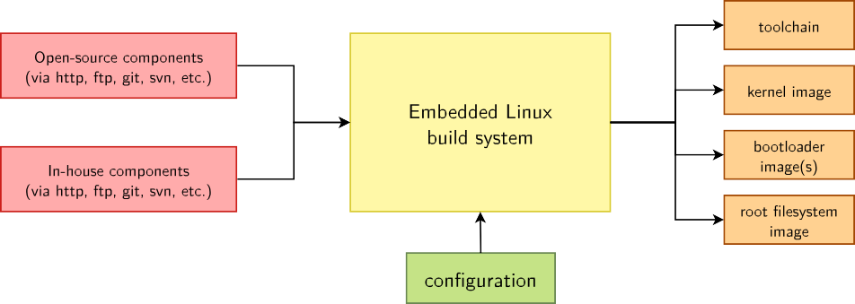
Embedded Linux build system: principle
Building from source → lot of flexibility​
Cross-compilation → leveraging fast build machines​
Recipes for building components → easy​

Slide 87
Embedded Linux build system: tools
Yocto/OpenEmbedded
A wide range of solutions: Yocto/OpenEmbedded, PTXdist, Buildroot, OpenWRT, and more.
Today, two solutions are emerging as the most popular ones
Builds a complete Linux distribution with binary packages. Powerful, but somewhat complex, and quite steep learning curve.
Builds a root filesystem image, no binary packages. Much simpler to use, understand and modify.
Buildroot

